Slide 1

Application layer: overview
P2P applications
video streaming and content distribution networks
socket programming with UDP and TCP
Principles of network applications
Web and HTTP
E-mail, SMTP, IMAP
The Domain Name System DNS

Slide 2

E-mail
user
agent
Three major components:
user agents
mail servers
simple mail transfer protocol: SMTP
User Agent
a.k.a. “mail reader”
composing, editing, reading mail messages
e.g., Outlook, iPhone mail client
outgoing, incoming messages stored on server
mail
server
user
agent
SMTP
mail
server
user
agent
SMTP
SMTP
user
agent
mail
server
user
agent
user
agent
outgoing
message queue
user mailbox

Slide 3
E-mail: mail servers
user
agent
mail servers:
mailbox contains incoming messages for user
message queue of outgoing (to be sent) mail messages
SMTP protocol between mail servers to send email messages
client: sending mail server
“server”: receiving mail server
mail
server
user
agent
SMTP
mail
server
user
agent
SMTP
SMTP
user
agent
mail
server
user
agent
user
agent
outgoing
message queue
user mailbox

Slide 4
SMTP RFC (5321)
“client”
SMTP server
“server”
SMTP server
uses TCP to reliably transfer email message from client (mail server initiating connection) to server, port 25
direct transfer: sending server (acting like client) to receiving server
three phases of transfer
SMTP handshaking (greeting)
SMTP transfer of messages
SMTP closure
command/response interaction (like HTTP)
commands: ASCII text
response: status code and phrase
initiate TCP
connection
RTT
TCP connection
initiated
220
SMTP handshaking
HELO
250 Hello
SMTP transfers
time

Slide 5


Scenario: Alice sends e-mail to Bob
1) Alice uses UA to compose e-mail message “to” bob@someschool.edu
4) SMTP client sends Alice’s message over the TCP connection
2) Alice’s UA sends message to her mail server using SMTP; message placed in message queue
5) Bob’s mail server places the message in Bob’s mailbox
3) client side of SMTP at mail server opens TCP connection with Bob’s mail server
6) Bob invokes his user agent to read message
user
agent
mail
server
user
agent
1
mail
server
2
3
6
4
Alice’s mail server
5
Bob’s mail server

Slide 6
Sample SMTP interaction
S: 220 hamburger.edu
C: HELO crepes.fr
S: 250 Hello crepes.fr, pleased to meet you
C: MAIL FROM: <alice@crepes.fr>
S: 250 alice@crepes.fr... Sender ok
C: RCPT TO: <bob@hamburger.edu>
S: 250 bob@hamburger.edu ... Recipient ok
C: DATA
S: 354 Enter mail, end with "." on a line by itself
C: Do you like ketchup?
C: How about pickles?
C: .
S: 250 Message accepted for delivery
C: QUIT
S: 221 hamburger.edu closing connection

Slide 7
SMTP: observations
comparison with HTTP:
HTTP: client pull
SMTP: client push
both have ASCII command/response interaction, status codes
HTTP: each object encapsulated in its own response message
SMTP: multiple objects sent in multipart message
SMTP uses persistent connections
SMTP requires message (header & body) to be in 7-bit ASCII
SMTP server uses CRLF.CRLF to determine end of message

Slide 8
Mail message format
SMTP: protocol for exchanging e-mail messages, defined in RFC 5321 (like RFC 7231 defines HTTP)
RFC 2822 defines syntax for e-mail message itself (like HTML defines syntax for web documents)
header lines, e.g.,
To:
From:
Subject:
these lines, within the body of the email message area different from SMTP MAIL FROM:, RCPT TO: commands!
Body: the “message” , ASCII characters only
header
blank
line
body

Slide 9
Retrieving email: mail access protocols
user
agent
e-mail access
protocol
user
agent
SMTP
SMTP
(e.g., IMAP, HTTP)
sender’s e-mail
server
receiver’s e-mail
server
SMTP: delivery/storage of e-mail messages to receiver’s server
mail access protocol: retrieval from server
IMAP: Internet Mail Access Protocol [RFC 3501]: messages stored on server, IMAP provides retrieval, deletion, folders of stored messages on server
HTTP: gmail, Hotmail, Yahoo!Mail, etc. provides web-based interface on top of STMP (to send), IMAP (or POP) to retrieve e-mail messages

Slide 10
Application Layer: Overview
P2P applications
video streaming and content distribution networks
socket programming with UDP and TCP
Principles of network applications
Web and HTTP
E-mail, SMTP, IMAP
The Domain Name System DNS

Slide 11
DNS: Domain Name System
people: many identifiers:
SSN, name, passport #
Internet hosts, routers:
IP address (32 bit) - used for addressing datagrams
“name”, e.g., cs.umass.edu - used by humans
Q: how to map between IP address and name, and vice versa ?
Domain Name System (DNS):
distributed database implemented in hierarchy of many name servers
application-layer protocol: hosts, DNS servers communicate to resolve names (address/name translation)
note: core Internet function, implemented as application-layer protocol
complexity at network’s “edge”

Slide 12
DNS: services, structure
DNS services:
hostname-to-IP-address translation
host aliasing
canonical, alias names
mail server aliasing
load distribution
replicated Web servers: many IP addresses correspond to one name
Q: Why not centralize DNS?
single point of failure
traffic volume
distant centralized database
maintenance
A: doesn‘t scale!
Comcast DNS servers alone: 600B DNS queries/day
Akamai DNS servers alone: 2.2T DNS queries/day

Slide 13

Thinking about the DNS
humongous distributed database:
~ billion records, each simple
handles many trillions of queries/day:
many more reads than writes
performance matters: almost every Internet transaction interacts with DNS - msecs count!
organizationally, physically decentralized:
millions of different organizations responsible for their records
“bulletproof”: reliability, security

Slide 14
DNS: a distributed, hierarchical database
Root DNS Servers
Root
…
…
.com DNS servers
.org DNS servers
.edu DNS servers
Top Level Domain
…
…
…
…
yahoo.com
DNS servers
amazon.com
DNS servers
pbs.org
DNS servers
nyu.edu
DNS servers
umass.edu
DNS servers
Authoritative
Client wants IP address for www.amazon.com; 1st approximation:
client queries root server to find .com DNS server
client queries .com DNS server to get amazon.com DNS server
client queries amazon.com DNS server to get IP address for www.amazon.com

Slide 15
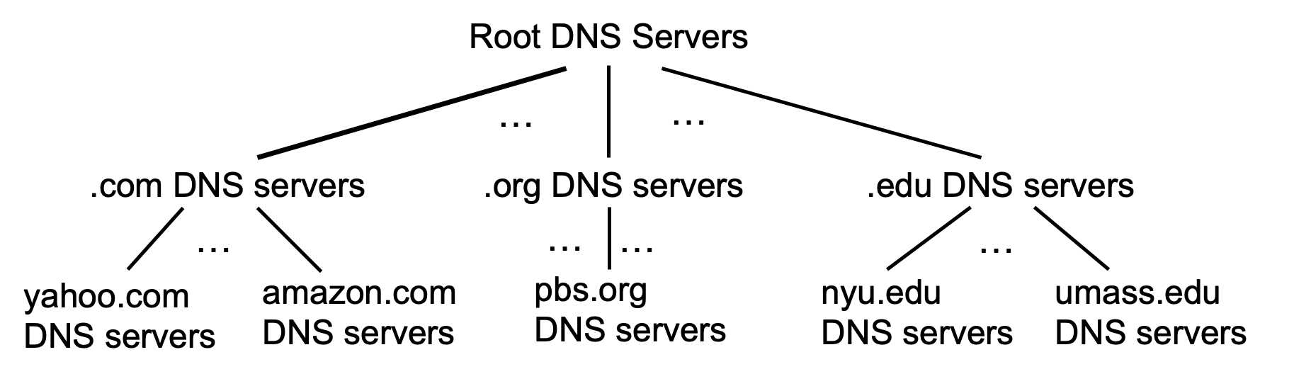
DNS: root name servers
official, contact-of-last-resort by name servers that can not resolve name

Slide 16
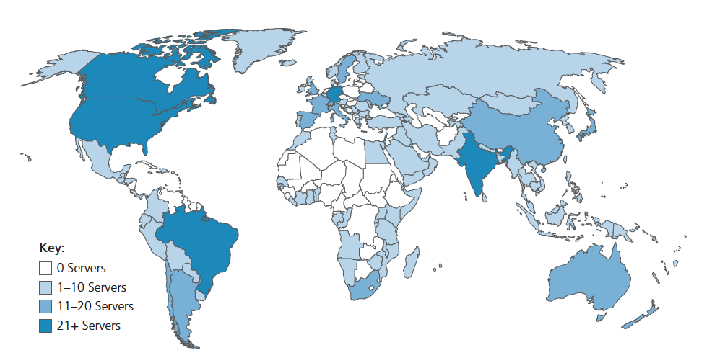
DNS: root name servers
official, contact-of-last-resort by name servers that can not resolve name
incredibly important Internet function
Internet couldn’t function without it!
DNSSEC – provides security (authentication, message integrity)
ICANN (Internet Corporation for Assigned Names and Numbers) manages root DNS domain
13 logical root name “servers” worldwide each “server” replicated many times (~200 servers in US)

Slide 17
Top-Level Domain, and authoritative servers
Top-Level Domain (TLD) servers:
responsible for .com, .org, .net, .edu, .aero, .jobs, .museums, and all top-level country domains, e.g.: .cn, .uk, .fr, .ca, .jp
Network Solutions: authoritative registry for .com, .net TLD
Educause: .edu TLD
authoritative DNS servers:
organization’s own DNS server(s), providing authoritative hostname to IP mappings for organization’s named hosts
can be maintained by organization or service provider

Slide 18
Local DNS name servers
when host makes DNS query, it is sent to its local DNS server
Local DNS server returns reply, answering:
from its local cache of recent name-to-address translation pairs (possibly out of date!)
forwarding request into DNS hierarchy for resolution
each ISP has local DNS name server; to find yours:
MacOS: % scutil --dns
Windows: >ipconfig /all
local DNS server doesn’t strictly belong to hierarchy

Slide 19
DNS name resolution: iterated query
root DNS server
Example: host at engineering.nyu.edu wants IP address for gaia.cs.umass.edu
2
3
TLD DNS server
Iterated query:
contacted server replies with name of server to contact
“I don’t know this name, but ask this server”
1
4
8
5
requesting host at
engineering.nyu.edu
local DNS server
dns.nyu.edu
gaia.cs.umass.edu
7
6
authoritative DNS server
dns.cs.umass.edu

Slide 20
DNS name resolution: recursive query
root DNS server
Example: host at engineering.nyu.edu wants IP address for gaia.cs.umass.edu
2
3
7
6
Recursive query:
puts burden of name resolution on contacted name server
heavy load at upper levels of hierarchy?
1
TLD DNS server
8
requesting host at
engineering.nyu.edu
local DNS server
dns.nyu.edu
5
4
gaia.cs.umass.edu
authoritative DNS server
dns.cs.umass.edu

Slide 21
Caching DNS Information
once (any) name server learns mapping, it caches mapping, and immediately returns a cached mapping in response to a query
caching improves response time
cache entries timeout (disappear) after some time (TTL)
TLD servers typically cached in local name servers
cached entries may be out-of-date
if named host changes IP address, may not be known Internet-wide until all TTLs expire!
best-effort name-to-address translation!

Slide 22
DNS records
DNS: distributed database storing resource records (RR)
RR format: (name, value, type, ttl)
type=A
name is hostname
value is IP address
type=CNAME
name is alias name for some “canonical” (the real) name
www.ibm.com is really servereast.backup2.ibm.com
value is canonical name
type=NS
name is domain (e.g., foo.com)
value is hostname of authoritative name server for this domain
type=MX
value is name of SMTP mail server associated with name

Slide 23
DNS protocol messages
DNS query and reply messages, both have same format:
2 bytes
2 bytes
message header:
identification: 16 bit # for query, reply to query uses same #
flags:
query or reply
recursion desired
recursion available
reply is authoritative
identification
flags
# questions
# answer RRs
# authority RRs
# additional RRs
questions (variable # of questions)
answers (variable # of RRs)
authority (variable # of RRs)
additional info (variable # of RRs)

Slide 24
DNS protocol messages
DNS query and reply messages, both have same format:
2 bytes
2 bytes
identification
flags
# questions
# answer RRs
# authority RRs
# additional RRs
name, type fields for a query
questions (variable # of questions)
RRs in response to query
answers (variable # of RRs)
records for authoritative servers
authority (variable # of RRs)
additional “ helpful” info that may be used
additional info (variable # of RRs)

Slide 25
Getting your info into the DNS
example: new startup “Network Utopia”
register name networkuptopia.com at DNS registrar (e.g., Network Solutions)
provide names, IP addresses of authoritative name server (primary and secondary)
registrar inserts NS, A RRs into .com TLD server:
(networkutopia.com, dns1.networkutopia.com, NS)
(dns1.networkutopia.com, 212.212.212.1, A)
create authoritative server locally with IP address 212.212.212.1
type A record for www.networkuptopia.com
type MX record for networkutopia.com

Slide 26
DNS security
DDoS attacks
bombard root servers with traffic
not successful to date
traffic filtering
local DNS servers cache IPs of TLD servers, allowing root server bypass
bombard TLD servers
potentially more dangerous
Spoofing attacks
intercept DNS queries, returning bogus replies
DNS cache poisoning
RFC 4033: DNSSEC authentication services

Slide 27
Application Layer: Overview
P2P applications
video streaming and content distribution networks
socket programming with UDP and TCP
Principles of network applications
Web and HTTP
E-mail, SMTP, IMAP
The Domain Name System DNS

Slide 28








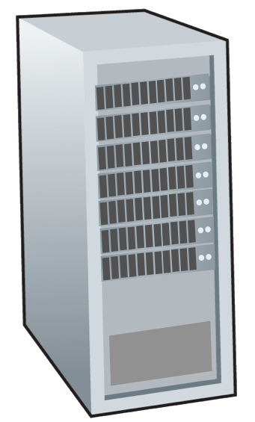







Peer-to-peer (P2P) architecture
no always-on server
arbitrary end systems directly communicate
peers request service from other peers, provide service in return to other peers
self scalability – new peers bring new service capacity, and new service demands
peers are intermittently connected and change IP addresses
complex management
examples: P2P file sharing (BitTorrent), streaming (KanKan), VoIP (Skype)
mobile network
national or global ISP
local or regional ISP
home network
content
provider
network
datacenter
network
enterprise
network

Slide 29
File distribution: client-server vs P2P
Q: how much time to distribute file (size F) from one server to N peers?
peer upload/download capacity is limited resource
u_{s}: server upload capacity
d_{i}: peer i download capacity
file, size F
u₁
d₁
u₂
u_{s}
d₂
server
d_{i}
u_{N}
network (with abundant
bandwidth)
u_{i}
d_{N}
u_{i}: peer i upload capacity

Slide 30
File distribution time: client-server
server transmission: must sequentially send (upload) N file copies:
time to send one copy: F/u_{s}
time to send N copies: NF/u_{s}
F
u_{s}
d_{i}
network
client: each client must download file copy
d_{min} = min client download rate
min client download time: F/d_{min}
u_{i}
time to distribute F
to N clients using
client-server approach
D_{c-s} > max{NF/u_{s,},F/d_{min}}
increases linearly in N

Slide 31
File distribution time: P2P
server transmission: must upload at least one copy:
time to send one copy: F/u_{s}
F
u_{s}
client: each client must download file copy
min client download time: F/d_{min}
d_{i}
network
u_{i}
clients: as aggregate must download NF bits
max upload rate (limiting max download rate) is u_{s} + Σu_{i}
time to distribute F
to N clients using
P2P approach
D_{P2P} > max{F/u_{s,},F/d_{min,},NF/(u_{s} + Σu_{i})}
increases linearly in N …
… but so does this, as each peer brings service capacity

Slide 32
Client-server vs. P2P: example
client upload rate = u, F/u = 1 hour, u_{s} = 10u, d_{min} ≥ u_{s}

Slide 33

P2P file distribution: BitTorrent
file divided into 256Kb chunks
peers in torrent send/receive file chunks
tracker: tracks peers
participating in torrent
torrent: group of peers exchanging chunks of a file
Alice arrives …
… obtains list
of peers from tracker
… and begins exchanging
file chunks with peers in torrent

Slide 34


P2P file distribution: BitTorrent
peer joining torrent:
has no chunks, but will accumulate them over time from other peers
registers with tracker to get list of peers, connects to subset of peers (“neighbors”)
while downloading, peer uploads chunks to other peers
peer may change peers with whom it exchanges chunks
churn: peers may come and go
once peer has entire file, it may (selfishly) leave or (altruistically) remain in torrent

Slide 35
BitTorrent: requesting, sending file chunks
Requesting chunks:
at any given time, different peers have different subsets of file chunks
periodically, Alice asks each peer for list of chunks that they have
Alice requests missing chunks from peers, rarest first
Sending chunks: tit-for-tat
Alice sends chunks to those four peers currently sending her chunks at highest rate
other peers are choked by Alice (do not receive chunks from her)
re-evaluate top 4 every10 secs
every 30 secs: randomly select another peer, starts sending chunks
“optimistically unchoke” this peer
newly chosen peer may join top 4

Slide 36
BitTorrent: tit-for-tat
(1) Alice “optimistically unchokes” Bob
(2) Alice becomes one of Bob’s top-four providers; Bob reciprocates
(3) Bob becomes one of Alice’s top-four providers
higher upload rate: find better trading partners, get file faster !

Slide 37
Chapter 2: Summary
our study of network application layer is now complete!
application architectures
client-server
P2P
application service requirements:
reliability, bandwidth, delay
Internet transport service model
connection-oriented, reliable: TCP
unreliable, datagrams: UDP
specific protocols:
HTTP
SMTP, IMAP
DNS
P2P: BitTorrent

Slide 38
Chapter 2: Summary
Most importantly: learned about protocols!
typical request/reply message exchange:
client requests info or service
server responds with data, status code
message formats:
headers: fields giving info about data
data: info(payload) being communicated
important themes:
centralized vs. decentralized
stateless vs. stateful
scalability
reliable vs. unreliable message transfer
“complexity at network edge”

